Slide 1
DESIGN PROJECT
DESIGN PHASE

Slide 2
SRS(Software Requirement Specification)
Final output of requirements task is the SRS
Why SRS?
  SRS focuses on external behavior
  UI have to be in SRS
  Error handling, constraints etc. also needed in SRS

Slide 3
Components of an SRS
What should an SRS contain ?
  Clarifying this will help ensure completeness
An SRS must specify requirements on
  Functionality
  Performance
  Design constraints
  External interfaces

Slide 4
Functional Requirements(system features)
Heart of the SRS document; this forms the bulk of the specs
Specifies all the functionality that the system should support
Outputs for the given inputs and the relationship between them
All operations the system is to do
Must specify behavior for invalid inputs too

Slide 5
Functional Requirements contd..
Should include
  Use case model
    Representation of user's interaction with system

Slide 6
Use case model
a use case model is developed to describe the requirements of the user
System behavior (or testable functionality or activity of a system) is captured in use cases.
Use case model describes the system functionality (use cases), its environment (actors) and the relationship between the system and its environment.
Use case model of a system consists of (a) use case diagrams (a pictorial representation of various system functions and its environment), (b) activity diagrams and (c) use case specifications.

Slide 7
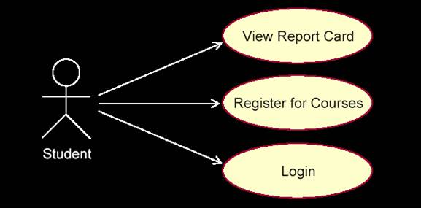
Use case model contd..
A Use Case Diagram has two basic elements:
  Actor - An actor represents anything (usually a human user or an external system) that interacts with the system and is represented by a stick man
  Use Case - A use case is a sequence of actions a system performs that yields an observable result of value to a particular actor. Use cases are represented using oval shape figures

Slide 8
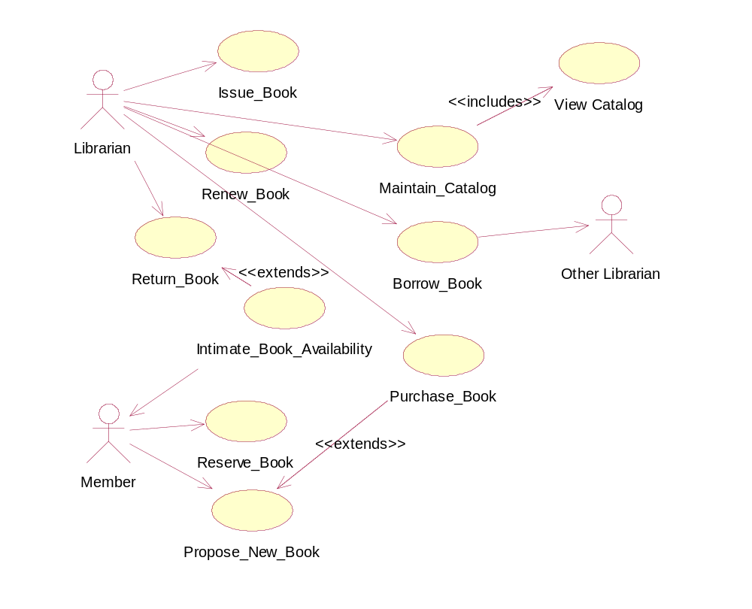

Slide 9
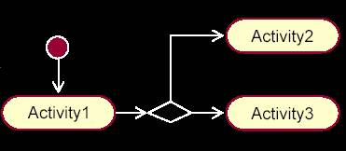
Activity Diagram
  An activity diagram in the use case model can be used to capture the activities in a use case.
  It is essentially a flow chart, showing flow of control from activity to activity.

Slide 10
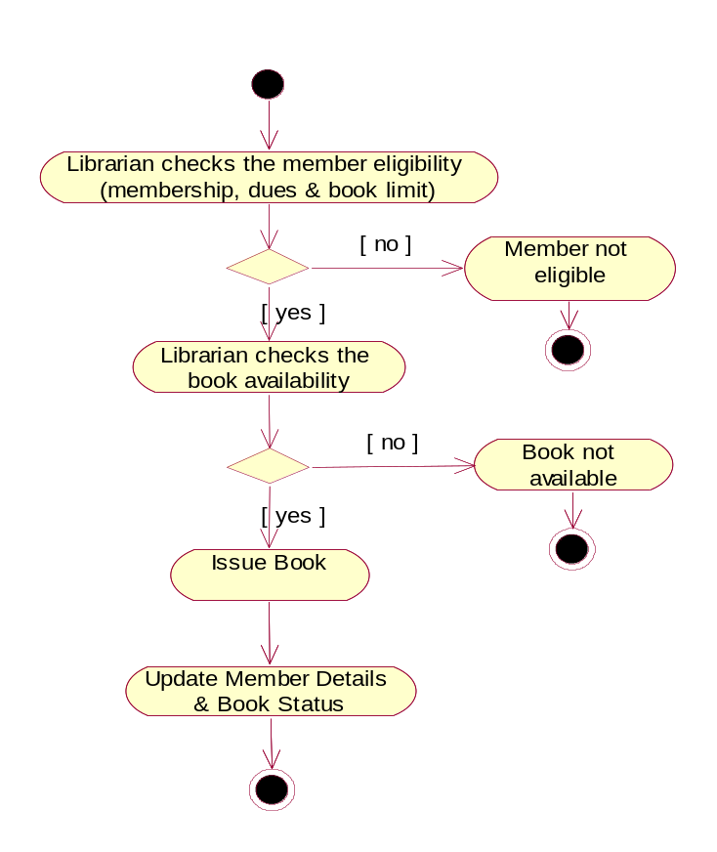
Issue Book – Activity Diagram

Slide 11
Use Case Specification
  Use case model of a system is incomplete without a use case specification for each use case in the system.
  Use case specification is usually a word document including the following contents:
    Name: Name of use case
    Brief Description: Brief description of the use case
    Actor: Role of actor
    Flow of Events: Sequence of activities (scenarios) in the use case. Usually, there will be one basic flow (success scenario) and several alternate flows (exceptional flows, failure scenarios etc.)
    Relationships: Relationship of this use case with other use cases
    Activity diagrams: Activity diagram of the use case
    Pre-conditions: Pre-requisites (or conditions) to be satisfied before this use case can be executed.
    Post-conditions: Condition (state) of the system after successful execution of this use case.

Slide 12
Performance Requirements
All the performance constraints on the software system
Generally on response time , throughput etc => dynamic
Capacity requirements => static
Must be in measurable terms (verifiability)
  Eg resp time should be xx 90% of the time

Slide 13
Design Constraints
Factors in the client environment that restrict the choices
Some such restrictions
Standard compliance and compatibility with other systems
Hardware Limitations
Reliability, fault tolerance, backup req.
Security

Slide 14
External Interface
All interactions of the software with people, hardware, and sw
User interface most important
General requirements of “friendliness” should be avoided
These should also be verifiable

Slide 15
Structure of an SRS
Introduction
  Purpose , the basic objective of the system
  Scope of what the system is to do , not to do
Overall description
  Product perspective
  Product functions
  User classes
  Development environment
  Assumptions
  Constraints

Slide 16
Structure of an SRS…
Specific requirements
  External interfaces
  Functional requirements(system features)
  Performance requirements
  Design constraints
This standardization of the SRS was done by IEEE.

